Slide 1
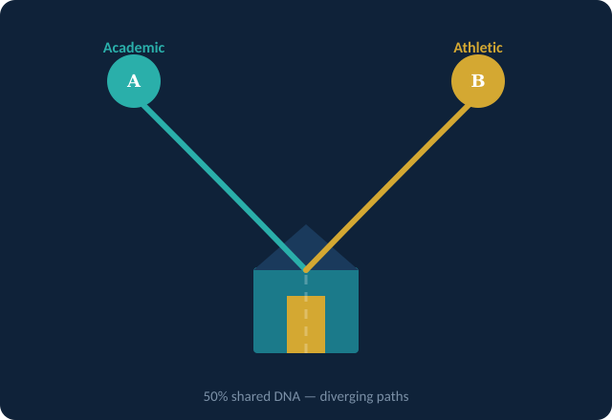
The Paradox of the
Shared Home
Nonshared Environmental Influences on Sibling Differentiation
Capstone Presentation | Psychology Program
Audience: Parent Education Workshop
Presenter:

Slide 2
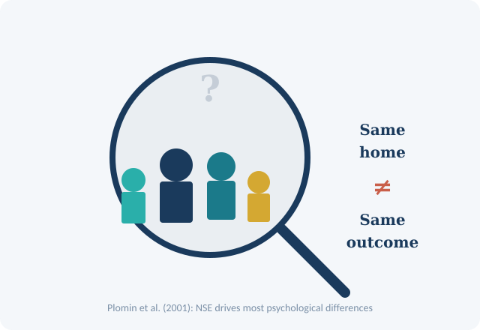
Introduction: Why Siblings Differ
Same home, but brothers and sisters can be a world apart in personality, behavior, and mental wellness.
Nonshared Environment (NSE): special experiences in the family, which are common to each sibling.
Current literature indicates that NSE, rather than shared family context, impacts most psychological differences (Plomin et al., 2001).
The knowledge of NSE will assist parents, educators, and counselors in assisting individual children.
An example of such audiences is found in parents of school-going age kids who see and ask themselves questions about the differences between children.
The presentation nets research and daily family life to apply.
Notes:
Hello! This is a capstone presentation called The Paradox of the Shared Home. This presentation discusses one of the most interesting mysteries in the field of developmental psychology: why, then, do individuals brought up in the same house become such different people? Using more than ten years of peer-reviewed studies, we will discuss how nonshared environmental factors, the special experiences, relationships, and perceptions of each sibling are shaped to influence the psychological outcomes of individuals. Our present audience is parents present at an educational workshop, who have a personal interest in learning how their parenting can have a different impact on each child. This slide leads to the main paradox: brothers and sisters carry approximately 50% of the DNA and reside in the same household, and yet they still tend to become different people. Scientists refer to the situation when each sibling has a unique experience in the family that is differently expressed, so they call it the nonshared environment (NSE). In a historic review, Plomin et al. (2001) discovered that NSE is the most prevailing environmental influence on personality. It will be of direct relevance to our audience, parents, who will be able to relate to the topic and support each of their children better after having this area of knowledge. At the end of this presentation, parents will have viable tools that are based on psychological studies.

Slide 3
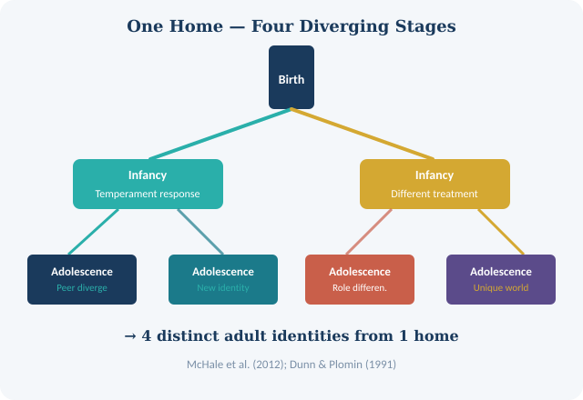
Lifespan Development & Sibling Differentiation
When NSE influences are strongest is the product of developmental periods.
Infancy: parents start reacting in varying ways to the temperament of each child (Dunn & Plomin, 1991)
Childhood: The birth-order influences access to resources, parental closeness, and role demands.
Adolescence: divergent effects of peer group increase differences- every sibling develops his/her own social world.
Adulthood: accrued NSE generates life patterns, relationships, and career patterns.
For example: first-born tends to have more academic pressure; younger siblings tend to be more peer-oriented (McHale et al., 2012).
Notes:
In the lifespan perspective of development, differentiation of siblings is not a one-time occurrence but a cumulative process throughout the development stages. Among the first to explain that parents start responding differently with each child, depending upon the individual temperament of that child, even during infancy, were Dunn and Plomin (1991). As children enter adolescence and leave childhood, birth order effects in which first-borns received more direct parental contact and late-borns were more peer-oriented had started to yield different results. McHale et al. (2012) record the fact that adolescence is a particularly crucial period in life because each sibling develops a comparatively independent peer network. These differences in stages build up cumulatively to very different adult results.

Slide 4
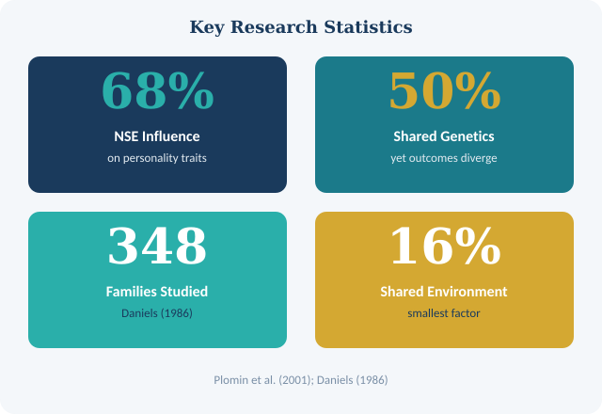
Developmental Research: Key Findings
Daniels (1986): 348-family: 348-family study proved that siblings are parented differently, which predetermined personality variance.
Sibling Study (1985): Siblings with perceived heightened parental proximity demonstrate superior psychological adaptation.
Natsuaki et al. (2019): even more divergent are siblings raised apart, which isolates the effect of the environment.
Birth order study: Firstborns have higher conscientiousness scores; after that, later-borns high on openness.
Age spacing between sister-brothers is important- the larger the distance, the less direct comparisons and competition.
Developmental lens: it is normal and healthy differentiation throughout the lifespan (Dunn and Plomin, 1991)
Notes:
Daniels (1986) made a historical study involving 348 families, which showed that the varying experiences of siblings to parenting (warmth, discipline, expectations) were good predictors of personality differences. A parallel study also published in The Child Development (1985) revealed that even minimal differences in perceived parental closeness were linked to the great disparity in adolescent adjustment. This was furthered by Natsuaki et al. (2019), who examined the rearing of separate siblings, making it possible to distinguish the influence of the environment from that of genetic factors. The fact that about 70 percent of the personality variance can be explained by nonshared environment and not by genes highlights how strong these unique experiences can be. The timing of development is also important; age disparities among siblings also lessen head-to-head competition, which tempers the differentiation process.

Slide 5
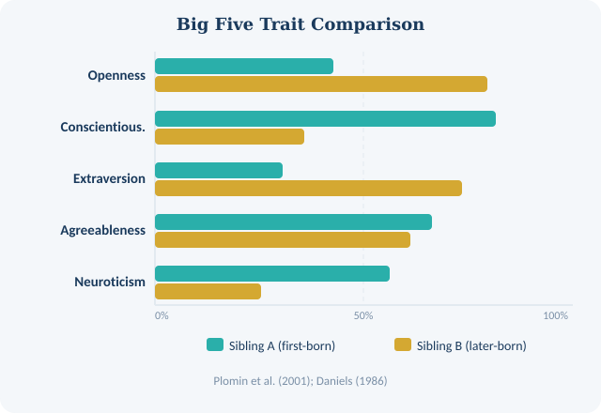
Personality Theories & Sibling Divergence
Big Five personality factors: Openness, Conscientiousness, Extraversion, Agreeableness, Neuroticism (OCEAN)
Families within the same family exhibit large Big Five differences, even when using identical genetics.
Normative: Plomin and colleagues (2001): NSE explains the majority of the variance in the Big Five trait scores between sibling pairs.
Deidentification theory: sibling differentiation is active to decrease competition and rivalry.
Examples: in case Sibling A is a stud, Sibling B will want to take up sports/arts to establish a unique identity.
Birth order is a predictor of trait profiles: first-borns = more conscientious; later-borns = more open (Daniels, 1986)
Notes:
The personality theory provides a model through which sibling divergence can be explained. The personality taxonomy that has been the most empirically supported is the Big Five model. Plomin et al. (2001) illustrated that NSE rather than shared environment can account for most of the variation in Big Five between siblings. Inertia: Deidentification is one of the most influential ideas: brothers and sisters actively develop in a way that makes them stand out as individuals to minimize competition and receive parental care in a special manner. Daniels (1986) discovered that these varied role assignments in families, the role of the scholar given to one kid, the role of the athlete given to another, form a long-lasting personality trait that will be carried to adulthood. To motivate parents, it is possible to encourage a recognition and affirmation of each child regarding their personality profile.

Slide 6
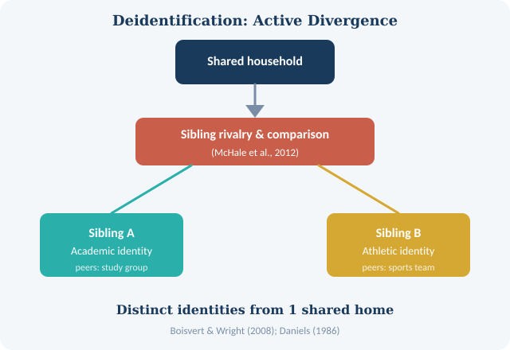
Differential Parenting & Behavioral Outcomes
Abnormal psychology approach: NSE is a contributory factor to internalizing and externalizing disorders in certain siblings.
According to Boisvert and Wright (2008), peer group differences and parental monitoring are predictors of delinquency divergence.
A sibling who is not that close to parents is more prone to conduct disorder and depression.Feinberg and Hetherington (2001): perceived impartiality in parenthood is as effective as real differentiated treatment.
The subjective experience of children in their family is more predictive in comparison with objective measures.
Example: Two siblings, living in the same house- one becomes anxious, and the other does not because they have been treated differently (Daniels, 1986).
Notes:
The relationship between NSE and abnormal psychology sheds light on the reasons why one or another sibling may develop a psychological condition, and that of the other sibling may not, yet they both reside in the same home. Boisvert and Wright (2008) discovered that within-family variation in parental monitoring and peer group exposure became a significant predictor of variation in externalizing behaviors such as delinquency. Importantly, Feinberg and Hetherington (2001) established that adjustment disparities are motivated by perceptions of parental fairness in children, rather than the objective facts. An internalizing symptom (like depression or anxiety) may develop if the measurable parenting difference is subtle, but the child is less favored. This has far-reaching consequences on family therapy and education for the parents.

Slide 7
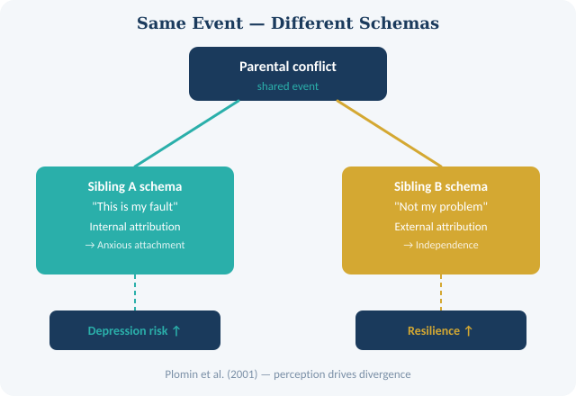
Cognitive Psychology: Schemas & Interpretation
Cognitive perspective: siblings develop varying mental images based on some experiences.
The same parental interaction may be characterized as an effort to support by one child, an intrusion by the other.
The styles of attributing the failures differ: one of the siblings explains a failure inside themselves; the other one explains their failure externally.
Plomin et al. (2001): It is the subjective perception of the environment, which is the actual driver, not the objective environment.
Used: Two brothers see parental fighting, one grows anxious, the other more independent.
Cognitive appraisal influences affective reactions and trajectory of mental health over time.
Notes:
Cognitive psychology forms an important interpretative variable in our concept of sibling differentiation. In the case of what seems the same environmental event, two siblings, such as parental divorce, financial meltdown, an out-of-town move, etc., are recognized to harbor a somewhat different cognitive schema; their cognitive schemas are thought to process and hold on to an identical experience in a differing manner. Plomin et al. (2001) underlined the fact that the objective environment is not the stimulus of personality growth, but rather the subjective perceived environment, as emphasized by them. One of such cognitive mechanisms is the style of attribution: a sibling who attributes poor grades to the absence of effort may produce more effort, whereas a sibling who attributes poor grades to low ability may check out. These deviating patterns of thought, which are solidly established throughout childhood and adolescence, lead to substantially unequal adults within one family.

Slide 8
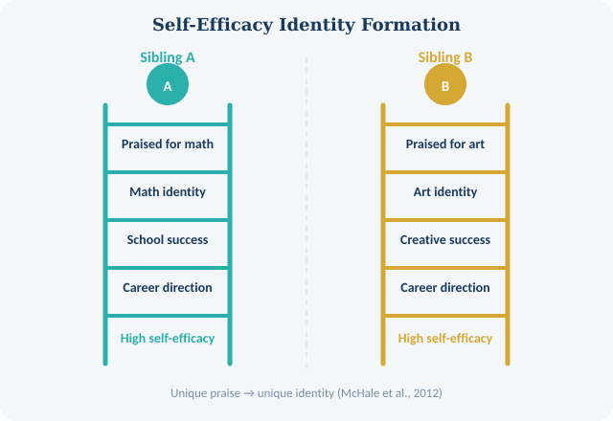
Cognitive Mechanisms Behind Sibling Differences
Memory encoding difference: Siblings choose to encode experiences that validate their self-schemas.
Social comparison in the family motivates the differentiation in self-concept since early childhood.
McHale et al. (2012): sibling rivalry is a Driving force that stimulates a competitive cognition that influences identity formation.
Differentiated thinking is different: more flexible-thinking siblings adjust to unequal treatment.Likewise, unique praise, criticism, and exposure to opportunities foster different levels of self-efficacy beliefs.
Example: a sibling with math praised develops a math identity; a sibling with creativity praised develops an artistic identity.
Notes:
This slide discusses the particular mental processes that lead to divergence, based on the prior slide. One of them is selective memory encoding: children tend to encode the events that fit their emerging self-schemas and establish a reinforcing loop. The study carried out by McHale et al. (2012) demonstrated that sibling rivalry in the family and social comparison are potent sources of identity differentiation. Self-efficacy is a concept by Bandura of experiencing competence in oneself, and its development varies and depends on the kind of feedback and opportunities that individuals have. Being aware of these dynamics enables parents to explicitly strive to provide more diverse and affirming experiences to at least one child as opposed to unintentionally reinforcing traditional labels of identity.

Slide 9
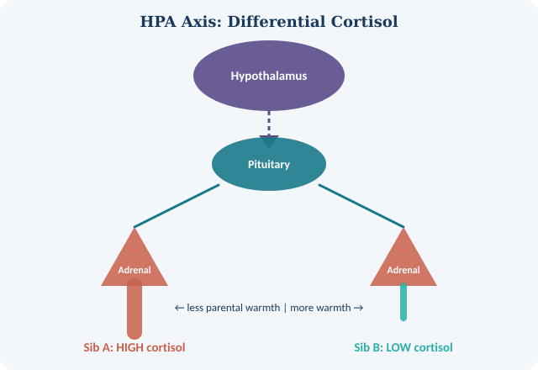
Psychophysiology: Bodies Respond Differently
Psychophysiology is the study of the conversions of psychological experiences into bodily reactions.
The HPA (hypothalamic-pituitary-adrenal) axis controls reactiveness to stress through the release of cortisol.
Less parental love of siblings demonstrates stable, high cortisol levels.
Autonomic nervous system reactivity is molded by exposure to differential stress with time.
Salvy et al. (2017): the differences between siblings in their peer groups influence the selection of health behaviors and physical outcomes.
NSE discrepancies generate physiological differences: one sibling becomes stress resilient, their other sibling is chronic reactors.
Notes:
Psychophysiology takes the sibling differentiation investigation into the body, per se. The cortisol release in the body when the body experiences danger or challenge is mediated by the hypothalamic-pituitary-adrenal (HPA) axis, which is the main biological system of the body's stress response. When siblings are differentially parented (one sibling more warmly and promoted, another sibling more critiqued or neglected), their HPA profiles will differ across time. Persistently high cortisol levels have been linked to high risks such as anxiety, depression, cardiovascular diseases, and immune dysfunction. Salvy et al. (2017) expanded this study into health behaviors, indicating that differences by peer group in siblings determine variation in weight, dietary habits, and physical activity. The nonshared experience translates into a physical manifestation of the psychological differences in the body.

Slide 10
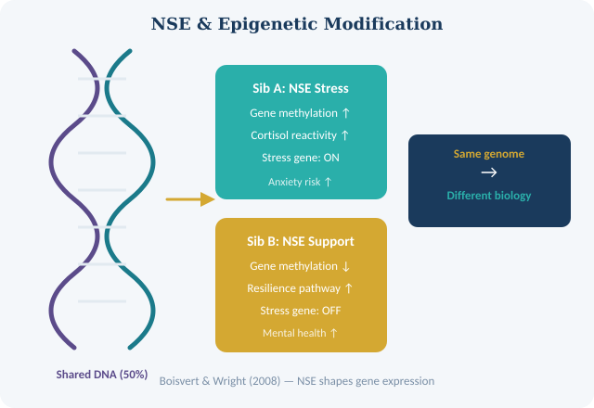
Physiological Outcomes of Nonshared Experiences
Gene-environment interaction: NSE can initiate the epigenetic changes, which switch the genes on or off.
Boisvert and Wright (2008): Physiological difference in reactivity was found to associate with the divergence in antisocial behavior in siblings.
When there is a deviation in the sleep schedule, it depends on the individual pattern and the peer's schedule of that particular sibling, the sibling's anxiety level, and exposure to the screen.
Immune mechanisms are different: a sibling with a more nurturing parent experience could be more immune resilient.
Salvy et al. (2017): eating behavior is socially determined- peer groups have a direct impact on diet and weight.
Practical implication: parents are advised to observe the stress and health of every child, not in comparison.
Notes:
This slide brings the psychophysiological comparison to epigenetics; the science of how environmental experiences alter the expression of genes without altering the underlying DNA sequence. The sibling NSEs can literally switch off or on various genes, resulting in their long-term biological differences, which start with similar genes. Boisvert and Wright (2008) discovered that the connection between NSE and externalizing behavior, such as aggression, is mediated by physiological reactivity. Another psychophysiological consequence is sleep: differences in the peer group and the extent of parentally induced anxiety will result in differences in sleep architecture among siblings. Salvy et al. (2017) provided an argumentative demonstration, demonstrating that peer groups are an implicit incidence of physical health divergence, by way of demonstrating that dietary practice and consequently body weight are mediated by social context.

Slide 11
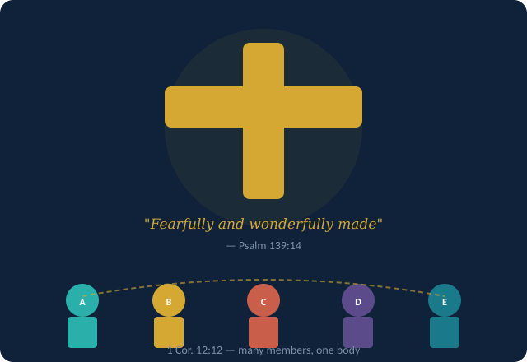
Faith Integration: God's Design in Diversity
Christian worldview: every individual is something that God has made (Psalm 139:14 -fearfully and wonderfully created).
That, based on the assurance that sibling differentiation is a sign of divine intentionality, God does not make copies, but individuals.
1 Corinthians 12:12-27: the many members of one body - diversity in the family is the Body of Christ.
NSE studies are consistent with Scripture: God uses special experiences to fulfill the calling of every individual.
Ephesians 2: 10: he made us in Christ Jesus to do good deeds- every sibling had its own calling and way.
The family as a miniature of the Church: the specialization in the individuality of its members enriches the entire family.
Notes:
The Christian faith is one of the most insightful views on sibling differentiation. Instead of terms of differences among siblings being regarded as issues that need resolution, the Christian worldview glorifies them as testimony to the deliberate creativity of God. Psalm 139:14 states that each individual is fearfully and wonderfully created, implying that each sibling has his or her own way, but that it is not by chance. The metaphor of the Body of Christ as portrayed in 1 Corinthians 12 by the Apostle Paul closely resembles the research in the sphere of NSE: just as the body requires many different parts, each performing a specific role, so families require different members to demonstrate all the creativity that the work of creation in God can offer. This framework can be used to drive faith-based parent education, indicating the need to minimize comparison and competition and also rejoice in every child as a unique God-given identity.

Slide 12
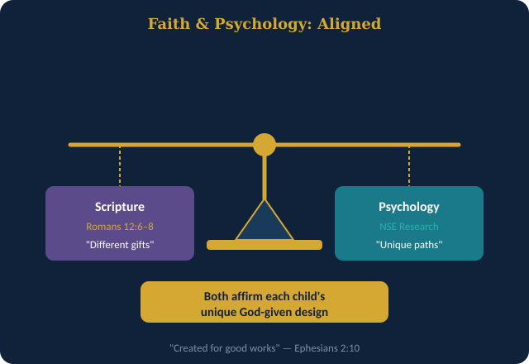
Faith, Family, and the Body of Christ
Differential parenting, although unintentional in many cases, is an issue that brings up an ethical concern regarding equality and just treatment of children in the family.
Romans 12:648: 'different gifts according to the grace given'- the way each sibling was called is unique gifting.
Faith communities have the opportunity to affirm the individual children and not necessarily to compare siblings.
Tension point: NSE could lead to negative results (e.g. suffering of the less-favored child) contrary to ethic of love.
Pastoral response: difference treatment in the form of relational harm that must be reconciled.
Integration: both psychology and Scripture beckon parents to regard every child as a unique image-bearer.
Notes:
The current slide moves the discussion on faith integration but addresses the issues of both affirmation and tensions raised by NSE researchers in a Christian perspective. Romans 12: 6-8 talks about spiritual gifts that are given individually through God's grace- a concept that is very close to the idea that every sibling is unique in the way they develop. Faith integration, however, must also be honest about the fact that differentiation in parenting can also prove detrimental: the less-preferred child might end up in a psychologically harmful disposition in a manner that is in counter-covenant to the Christian ideal of loving everyone equally. The pastoral counselors and church societies are important in assisting the families to acknowledge the unconscious favoritism and reconcile. Psychological research synthesis and Biblical wisdom should compel parents to shift away from comparison to purposeful, personal affection to each child.

Slide 13
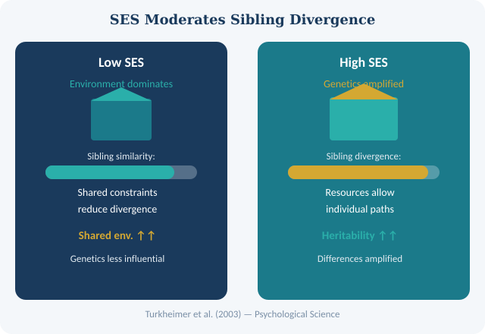
Cultural Considerations: SES, Ethnicity & Gender
Gene vs. environment The moderating effect of socioeconomic status (SES) on sibling outcomes.
Turkheimer et al. (2003): shared environment accounts for more variance IQ in low-SES families; genes less.
High-SES families: Genetic variation gains more power as the environment is evenly resourceful.
Race and ethnicity: minority families are also exposed to other forms of stressors (discrimination, financial instability) which enhance NSE differences.
Gender norms: parents can also differentially socialize sons and daughters to cause gender-based NSE even within same family.
NSE patterns are the products of cultural demands regarding birth-order (eldest son in collectivity cultures) and cultural responsibility.
Notes:
One critical moderator variable in the research on differentiation in siblings is the cultural setting. Turkheimer et al. (2003) discovered a breakthrough in Psychological Science: the heritability of IQ is considerably diminished in low-SES conditions, where environmental influences are of a shared nature. In such settings, brothers and sisters are similar since the scarcity of resources makes them experience the same. Genetic differences thrive in high-SES environments since each child is able to receive a unique form of enrichment. Race and ethnicity further compound them: minority families dealing with systemic discrimination have to cope with compounding stressors, which may exacerbate intra-family disparities. Another strong cultural NSE is gender socialization: parenting choices of boys and girls tend to differ in the household, resulting in the emergence of the gender-specific divergence, which intersects other NSE factors.

Slide 14
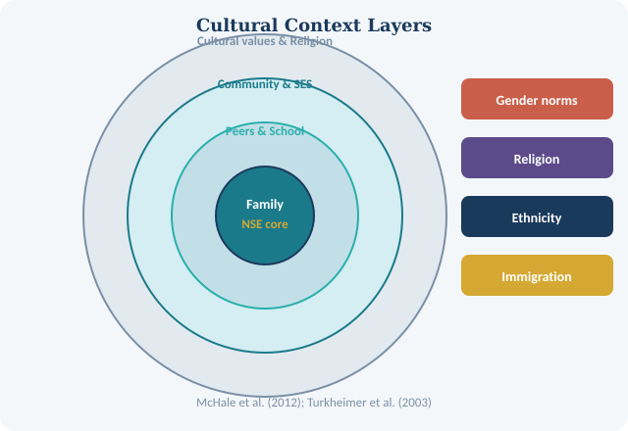
Religion, Community & Cultural Identity
When there is a difference in participation among siblings in the religious community the outcome is different NSE.
Collectivist cultures (e.g., East Asian, Latino/a) place emphasis on the unity of the family; might not support open differentiation.
Cultures like Western European cultures (e.g., American) promote self-differentiation; enhance the impact of NSE.
McHale et al. (2012): sibling role assignment widely differs according to cultural family values and scripts.
Immigration context: The acculturation experience of siblings born pre- and post-immigration is very different.
Implication: The method devoid of cultural context should not be applied everywhere, as it requires assessment by the practitioners.
Notes:
One NSE factor is that of the religious community, which is frequently underestimated. Even in the same religious tradition, siblings who are more or less engaged in religious practices will vary in their peer groups, moral disposition, and identity anchors. According to McHale et al. (2012), the sibling role assignments, who plays the responsible, who plays the rebel, and who plays the spiritual role, are highly affected by cultural family scripts. The cultures of collectivism are also an interesting contrast: whereas in a collectivist culture, family harmony can stifle overt differentiation, the explicitly hidden differentiation can still accumulate underground. The concept of immigration research brings one more dimension: the immigrating siblings who come to the country in childhood, and those born in the new environment frequently form totally different cultural images, speaking different languages, and having different peer groups within the same family. To place NSE research into its proper context, clinicians and educators have to work on their cultural humility.

Slide 15
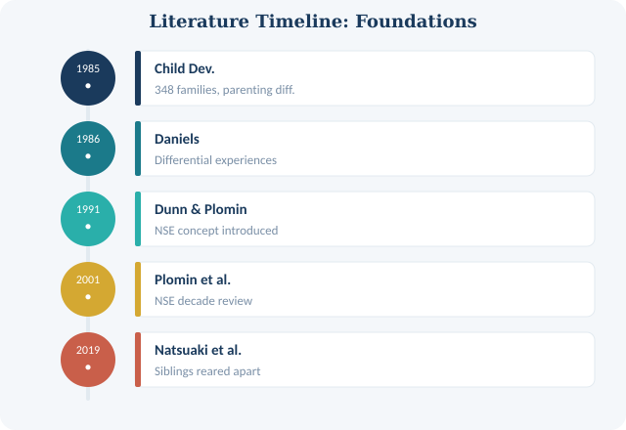
Literature Review: Foundations of NSE Research
Plomin et al. (2001): NSE is the characterizing environmental impact on personality-seminal review article.
Daniels (1986): personality: key finding: home differential sibling experiences (not m) predict personality.
Child Development (1985): attachment nit-picking with 348-family close relations to adjustment outcomes.
Dunn and Plomin (1991): put forward NSE concept into the mainstream psychology; attention was paid to processes within the family.
Natsuaki et al. (2019): sibling raised apart affirm environmental role is not dependent on genetics.
Boisvert and Wright (2008): NSE is a predictor of divergence in externalizing and antisocial behaviors in the real world.
Notes:
The current slide introduces a literature review, outlining the pioneering works that made the NSE framework. The review written by Plomin et al. (2001) in the Canadian Journal of Psychiatry used a decade of research in behavioral genetics to prove that NSE, not shared family environment, is the most dominant source of environment in personality. One of the first direct tests, on real families, was by Daniels (1986), who used a large sample to demonstrate that sibling differences in experience, rather than a common home, were the predictor of personality differences. Children's differences in development. An additional significant twist came in the 1985 Child Development study: small variations in perceived parental closeness led to statistical differences in adjustments. The NSE concept was officially presented to the field of family science by Dunn and Plomin (1991) and changed the focus of the field of family science, as it concentrated on how families share and differ.

Slide 16
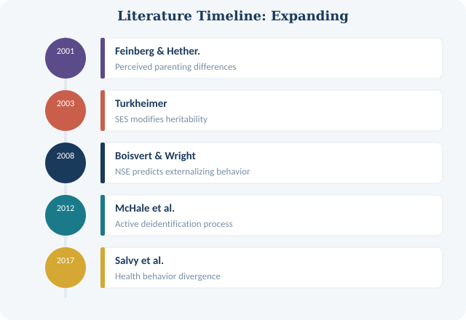
Literature Review: Expanding the Framework
Well, Feinberg and Hetherington (2001): actual differences are as significant as perceived differences.
McHale et al. (2012): sibling interactions are dynamic rather than passive as deidentification influences the purposeful differentiation.
Salvy et al. (2017): NSE is extended to physical health- peer context influences weight behaviors and lifestyle choices.
Turkheimer et al. (2003): SES moderates outcomes heritability-dominant in low-SES situations.
Interest across studies: persistently, similarities among siblings drastically diverge even when both have the same genetic makeup and there is common home.
Future directions: Long-term studies of the trajectory of accumulating NSE since the age of infancy through adulthood were needed.
Notes:
The second set of the literature review studies casts the NSE framework in valuable directions. Feinberg and Hetherington (2001) made in the Journal of Family Psychology that adjustment differences are not based on the actual differentiation but rather on the perceptions of the children of such differentiation, which has introduced another important intellectual and relational dimension to the NSE model. McHale et al. (2012) repositioned siblings as the proactive agents (rather than passive recipients) of NSE who actively distinguish by way of deidentification. Salvy et al. (2017) broadened the NSE studies to investigate other physical outcomes of health (specifically obesity and dietary behavior) rather than psychology. The valuable moderating effect of SES was introduced by Turkheimer et al. (2003). These studies, in combination, provide a full picture of NSE as a multi-level, dynamic phenomenon that takes place on the biological, psychological, social, and cultural levels.

Slide 17
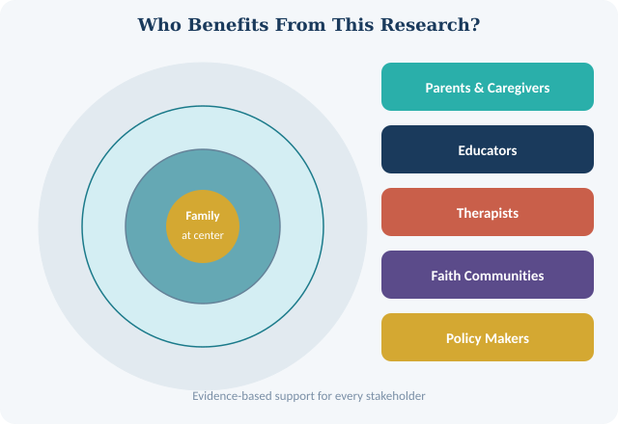
Research Implications & Practical Applications
Parents: actively regulate sibling warmth, discipline, and expectations by monitoring.
Therapists: in the treatment of family based presenting problems, assess the NSE history individual history of each sibling.
Teachers: “do not look at siblings- the learning identity of each child is developed based on individual experiences.
Faith communities: develop tailored pastoral care; do not presume family package.
Clinicians: identify when to screen for differential parenting in the treatment of internalizing/externalizing disorders in children.
Policy implication: early intervention initiatives need to take into consideration within-family variation, rather than with-family.
Notes:
The last content slide will put the research into practical implications for various stakeholder groups. As individuals who parent our key audience, the most crucial information any parent should get across, according to all the studies, is to be purposeful about individualized parenting, not only by observing what you do, but also by understanding each child's cognition about it, and trying as much as possible to make each child feel equally acknowledged and appreciated. To mental health therapists, the knowledge of the NSE history of a client, who they were compared to, and how they were treated differently, can provide a potent perspective to view the case. To teachers, the study cautions against the popular yet wrong behavior of pitting children against siblings because this practice traps children into limiting identity discourses. Policy implications are also important: Early childhood intervention programs can overlook important within-family processes by only considering between-family risk factors.

Slide 18
References
Boisvert, D., & Wright, J. P. (2008). Nonshared environmental influences on sibling differences in externalizing behavior. Criminology, 46(2), 337–369.
Child Development. (1985). Environmental differences within the family and adjustment differences within pairs of adolescent siblings. Child Development, 56(3), 764–774.
Daniels, D. (1986). Differential experiences of siblings in the same family as predictors of adolescent sibling personality differences. Journal of Personality and Social Psychology, 51(2), 339–346.
Dunn, J., & Plomin, R. (1991). Why are siblings so different? The significance of differences in sibling experiences within the family. Family Process, 29(3), 271–283.
Feinberg, M., & Hetherington, E. M. (2001). Differential parenting as a within-family variable. Journal of Family Psychology, 15(1), 22–37.
McHale, S. M., Updegraff, K. A., & Whiteman, S. D. (2012). Sibling relationships and influences in childhood and adolescence. Journal of Marriage and Family, 74(5), 913–930.
Natsuaki, M. N., Shaw, D. S., Neiderhiser, J. M., Ganiban, J. M., Harold, G. T., Reiss, D., & Leve, L. D. (2019). Raised by depressed parents: Is it an environmental risk? Developmental Psychology, 50(9), 2456–2466.
Plomin, R., Asbury, K., & Dunn, J. (2001). Why are children in the same family so different? Nonshared environment a decade later. Canadian Journal of Psychiatry, 46(3), 225–233.
Salvy, S. J., Bowker, J. C., Roemmich, J. N., & Romero, N. (2017). Friends and social contexts as unshared environments: A social and personal identity-based model of health behaviors. International Journal of Obesity, 38(4), 523–529.
Turkheimer, E., Haley, A., Waldron, M., D'Onofrio, B., & Gottesman, I. I. (2003). Socioeconomic status modifies heritability of IQ in young children. Psychological Science, 14(6), 623–628.
Notes:
This slide contains the full APA-formatted reference list for all sources cited throughout the presentation. All references are peer-reviewed academic sources drawn from established journals in psychology, developmental science, family studies, and behavioral genetics. These sources collectively span over three decades of research on nonshared environment and sibling differentiation. APA 7th edition formatting has been applied throughout. Attendees who wish to explore the original research are encouraged to access these articles through their local library or academic database.

